Slide 1
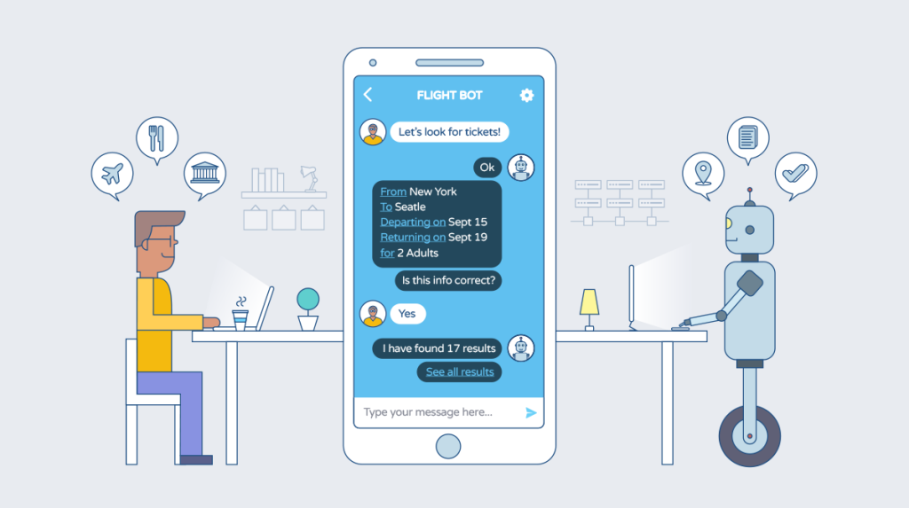
UHC INSURANCE AGENT
the Frontier of ADVANCED TECHNOLOGY IN Health Care

Slide 2
Team name: Algo Engineers
Team members:
Koti Swaroop Tadepalli
Mohammad Adil Baig
Bharath Kumar Burla

Slide 3
Our approach towards Health care
Problem Statement: Every year UHC receives Millions of calls related to Benefits and coverage of health insurance plans. This is costing UHC both in terms of money and customer satisfaction.
Waiting time of users to get their questions answered is more
Maintaining support staff is challenging.
Solution proposed: Using NLP(Natural language processing) with Virtual agent (ServiceNow) we have developed a solution to answer the customer queries. This solution will be able to tackle the nuances in the customer queries and will provide the required information with minimal efforts. With this we can reduce the user waiting time and also will cut the cost to the companies

Slide 4
Technology used, ServiceNow and Why???
Our UHG is already using ServiceNow in multiple departments like HR, Software requests etc.
Global leader in digital transformation and automation
It is a cloud based platform with high reliability
Minimal maintenance and easy initial setup which are key for the companies like our UHC.

Slide 5
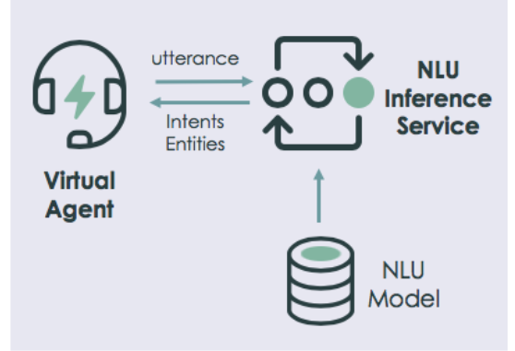
Solution synopsis and Demonstration
Apply Natural Language Understanding (NLU) models that enable virtual agent to understand user statements in automated conversations. An NLU model provides information that virtual agent uses to determine what users want to do and to extract relevant values from their input. With NLU, virtual agent can offer a more natural and engaging conversational experience.

Slide 6
Future scope of the virtual agent
Agent will support multiple languages
Effective communication by providing data in terms of images and articles as required.
Dealing with fallbacks and improving in performance by readily available dashboards

